Slide 1

NYC Government
Joel Grayson & Mr. Kildahl
Notes:
45 minutes
1/19 AV Room 1–1:45pm
Goal of independent study was to understand how NYC’s government works.
Changes to respond to the problems that the city faces, which have changed drastically from farming to manufacturing to office work to ?

Slide 2

December 2023
The People of the City of New York
Boroughs of the Bronx, Brooklyn, Manhattan, Queens, and Staten Island
Office of the Mayor
Borough Presidents
The Bronx | Brooklyn | Manhattan Queens | Staten Island
Comptroller
Mayor
Public Advocate
The City Council 51 Council Members
Independent Budget Office
All District Attorneys
The Bronx: 8 Members Brooklyn: 16 Members
Manhattan: 10 Members
Queens: 14 Members Staten Island: 3 Members
City Clerk Clerk of the Council
Borough Boards
Community Boards
Financial Information Services Agency
Office of Payroll Administration
Procurement Policy Board
Office of Special Narcotics
Department of Education
Chief Advisor to the Mayor
Chief of Staff
Chief Counsel to the Mayor and City Hall
Intergovernmental Affairs
Equal Employment Opportunity
First Deputy Mayor
Law Department
Department of Investigation
Police Department
Deputy Mayor for Public Safety
Deputy Mayor for Communications
Office of Appointments
Office of International Affairs
Office of Administrative Trials and Hearings
Deputy Mayor for Strategic Initiatives
Deputy Mayor for Housing, Economic Development & Workforce
Chief Technology Officer
Office of Management and Budget
Deputy Mayor for Operations
Deputy Mayor for Health and Human Services
Fire Department
Director of Communications
Office of Administrative Services
Office of Contract Services
Office of Efficiency
Department of Correction
Office of Operations
Economic Development Corporation
Office of Minority and Women-Owned Business Enterprises
Speechwriting
Office of Special Projects and Community Events
Office of Labor Relations
Office of Nonprofits
Office of Technology and Innovation
Chief Climate Officer
Health + Hospitals
NYC Emergency Management
Department of Youth and Community Development
Department of Small Business Services
NYC 311
Office of Policy and Planning and Delivery
Office of Climate and Environmental Justice
Department of Social Services
Department of Probation
Press Office
Office of Citywide Event Coordination and Management
Business Integrity Commission
Office of Media & Research Analysis
Commission on Human Rights
Office of Food Policy
Department of Consumer and Worker Protection
NYC Cyber Command
Office for Economic Opportunity
Office of Environmental Remediation
Human Resources Administration
Office of Municipal Services Assesment
Gracie Mansion
Center for Innovation through Data Intelligence
Office of Environmental Coordination
Department of Homeless Services
Office of Ethnic and Community Media
Scheduling and Executive Operations
Department of Records and Information Services
Department of City Planning
Office of Data Analytics
Office of Strategic Partnerships
Office of Criminal Justice
Conflicts of Interest Board
Children’s Cabinet
Department of Cultural Affairs
Office of Information Privacy
Department of Citywide Administrative Services
Department of Environmental Protection
Department of Health and Mental Hygiene
Office of Creative Communications
Advance
Department of Sanitation
Administration for Children’s Services
Office of Correspondence
Office for People with Disabilities
Office of Equity
Office of Media and Entertainment
Department of Finance
Department for the Aging
Office of Risk Management and Compliance
Young Men’s Initiative
NYC Media
Department of Transportation
Office of Engagement
Sheriff
Department of Parks and Recreation
Office of the Chief Medical Examiner
Public Engagement Unit
Office of Administrative Justice Coordinator
Commission on Gender Equity
Office of Film, Theater & Broadcasting
Office of Pensions and Investments
Department of Design and Construction
Office of Immigrant Affairs
NYC Service
Mayor’s Judiciary Committee
Unity Project
Office of Nightlife
School Construction Authority
Office to End Domestic and Gender-Based Violence
Civilian Complaint Review Board
Office of Childcare and Early Childhood Education
Landmarks Preservation Commission
Civic Engagement Commission
Department of Buildings
Department of Veterans’ Services
Community Affairs Unit
Commission to Combat Police Corruption
Mayor’s Fund & Office of Nonprofits
Office of Talent and Workforce Development
Taxi and Limousine Commission
Office of Community Mental Health
City University of New York
Public Design Commission
Office of Capital Project Development
Office of Animal Welfare
NYC
Tourism & Conventions
Office of Emerging Markets
New York City Housing Authority
Office of Sports Wellness & Recreation
Department of Housing Preservation
and Development
Office of Asylum Seeker Operations
Housing Development Corporation
Housing Recovery Operations
Office to Protect Tenants
Notes:
Huge. 330,000 city employees. Many different departments.
It’s like a complex organism.

Slide 3
What Does It Do?
Schools
Libraries
Hospitals
Public housing and parks
Subways, buses
Police & Fire
Sanitation
Help businesses
Notes:
NYC government affects all sorts of aspects of our day-to-day lives.

Slide 4
Federalism
Executive
Legislative
Judicial
Federal
President
Congress
Courts
State
Governor
State Legislature
NYS Unified Court System
City
Mayor
City Council
Borough
Borough President & Borough Boards
Borough DAs
Districts
Community Boards
Notes:
U.S. government has division of power between different branches

Slide 5
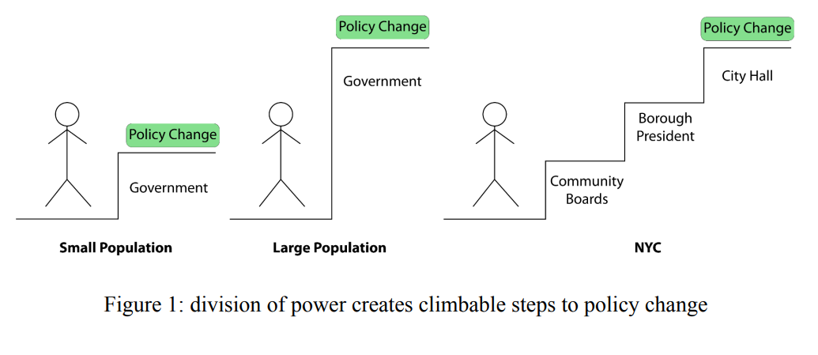
Federalism
Notes:
What’s the point of all this division?
Benefit of division of power is easier for change to occur
Trend towards decentralization

Slide 6
Mayor
Oversees city agencies
  Appoints commissioners
  Can create or destroy city agencies
Proposes budget
Can veto bills
Represents city to rest of world
~5 deputy mayors - intermediaries
Notes:
Fire department, Police department, education department all under the mayor
Create or destroy city agencies
For example, Bloomberg created 311 in 2003
https://docs.google.com/document/d/14GYfjmlh8tJiCvTVa7yEWBQ07BAeo3Ve1xt9Hhk0KYA/edit

Slide 7
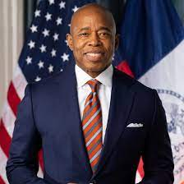
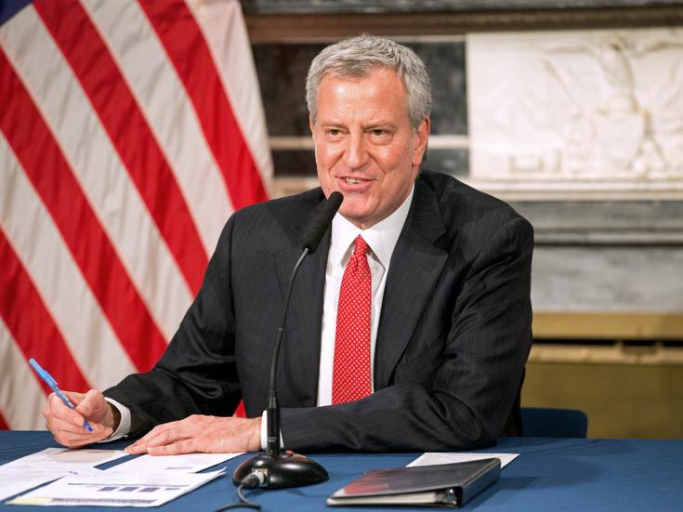
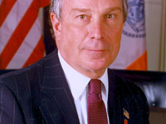
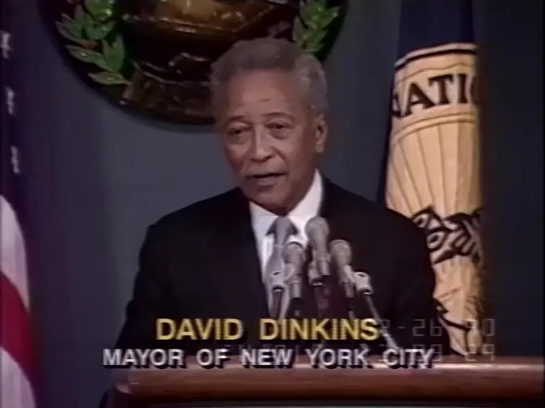
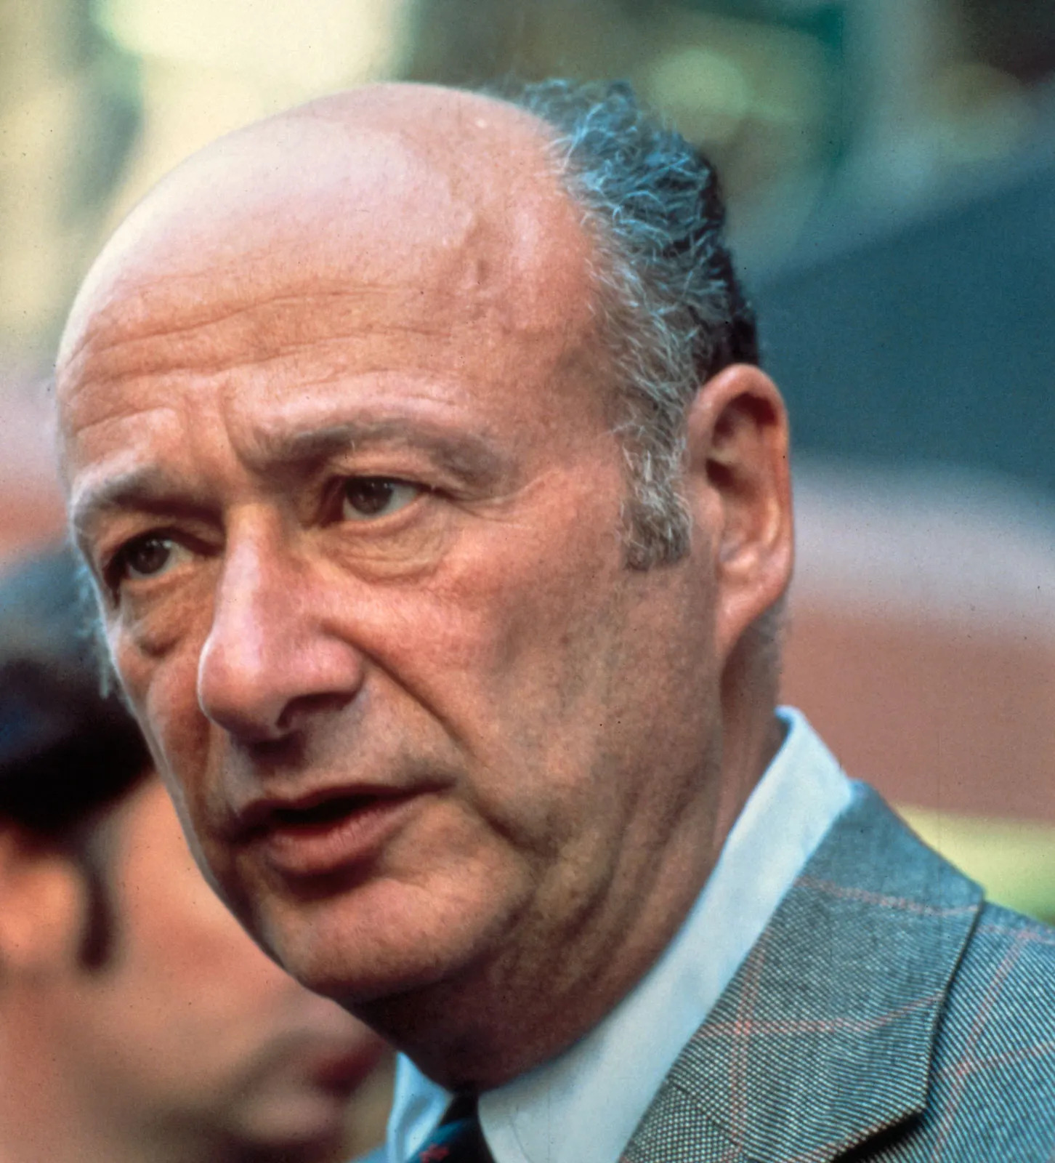
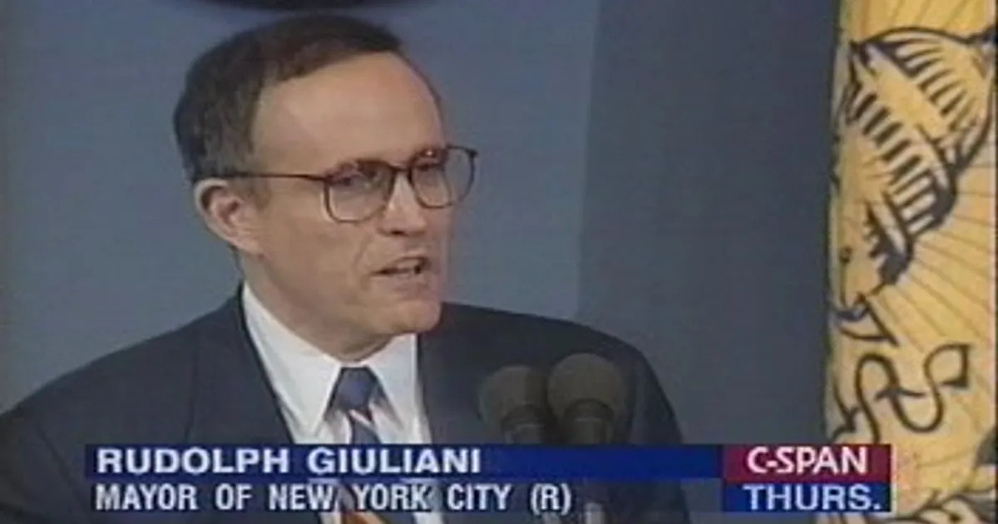
Recent Mayors
Eric Adams
Bill de Blasio
Michael Bloomberg
Rudy Giuliani
David N. Dinkins
Ed Koch
Abraham Beame
John Lindsay
Robert F. Wagner
Fiorello La Guardia
Notes:
Many mayors elected in response to predecessors’ shortcomings
Dinkins was a reaction to Ed Koch, who created racial tension by being racially insensitive in his comments and closing down a hospital serving a Black neighborhood.
Giuliani
Bloomberg was elected in response to 9/11, as a need for a businessman to revive the city.
De Blasio was elected in response to five Republican terms (three terms of Bloomberg and two terms of Giuliani).
Adam's was elected in response to the police violence and Black Lives Matter.

Slide 8
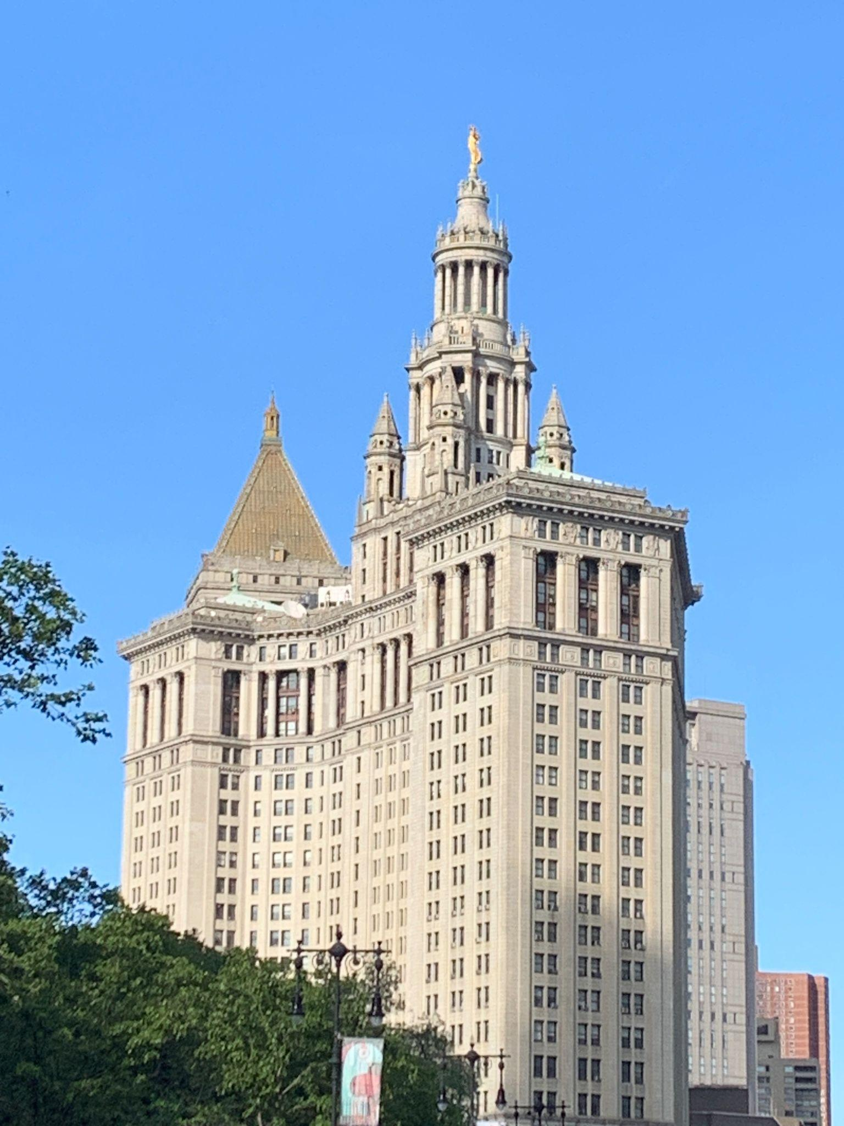
Departments
Department of Education (DoE)
Police Department (NYPD)
Fire Department (FDNY)
Department of Building (DoB)
NYC Health + Hospitals
Department of Social Services (DSS)
Department of Transportation (DOT)
Department of Sanitation (DSNY)
Department of City Planning (DCP)
Department of Design and Construction (DDC)
Department of Consumer and Worker Protection (DCWP)
NYC Housing Authority (NYCHA)
Department of Housing Preservation and Development (HPD)
Department of Environmental Protection (DEP)
Mayor’s Office of Climate and Environmental Justice (MOCEJ)
…
Notes:
https://docs.google.com/document/d/1t3dpz9rwghd8Xug4D3p1fLJXQQWWvorGu7n-SrJkzbM/edit
Education
Largest school system
1.1 million students
$38 billion
Fire department also runs most ambulances
Buildings
Department of Building
Inspects elevators and boilers periodically
NYCHA - public housing
Department of Housing Preservation and Development (HPD) -
Rent Guidelines Board - sets the rates for rent-stabilized housing
Largest municipal hospitals system: NYC Health and Hospitals
Non-mayoral agency
Manages a municipal hospital system
Serves 1.5 million New Yorkers
Department of Hygiene and Mental Health
### Not included

Slide 9
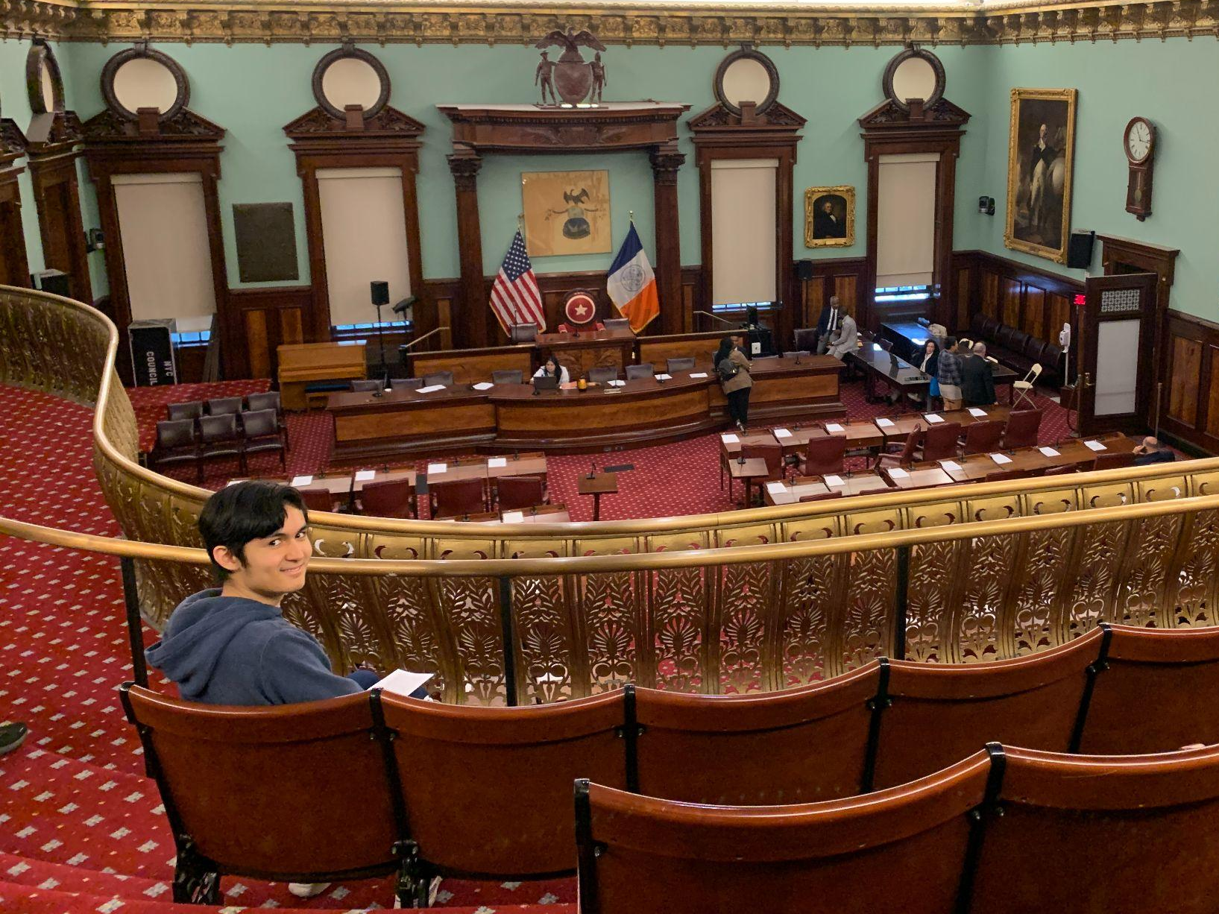
City Council
Consists of
  51 councilmembers
    Different flavors of Democrats
  Stated meetings
  35 commitees
Powers
  Pass local legislation
  Budget
  Land use
  Councilmember discretionary budget
Field trip!
Notes:
Mayor > City Council
President < Congress

Slide 10
Accountability
Comptroller
Independent Budget Office (IBO)
Public Advocate
Conflict of Interest Board (COIB)
NYC Campaign Finance Board
Notes:
Even though there has been a fair amount of corruption in NYC government, the structure is trying to prevent that.
Comptroller - audits the city’s spending and produces reports
Independent Budget Office also produces reports
Public advocate - unique position
That being said there is still corruption
Many mayor scandals

Slide 11
Borough Presidents
Official power: much less than in old days
  Role in budgeting and ULURP
  Appoints community board members
Self-defined position
  Advocating for community
  Fund projects
  Request legislation be passed for them
Notes:
Now that we have talked about the citywide, let’s talk about at the borough level.
Mr. Kildahl and I read a 20-page law review on whether we even need this position.

Slide 12
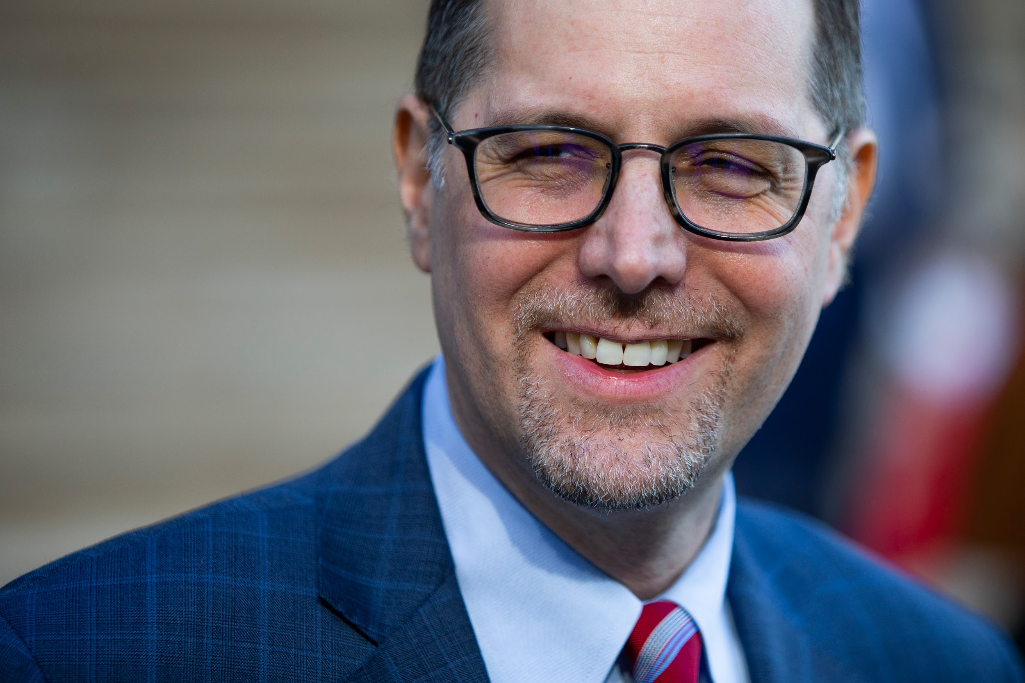
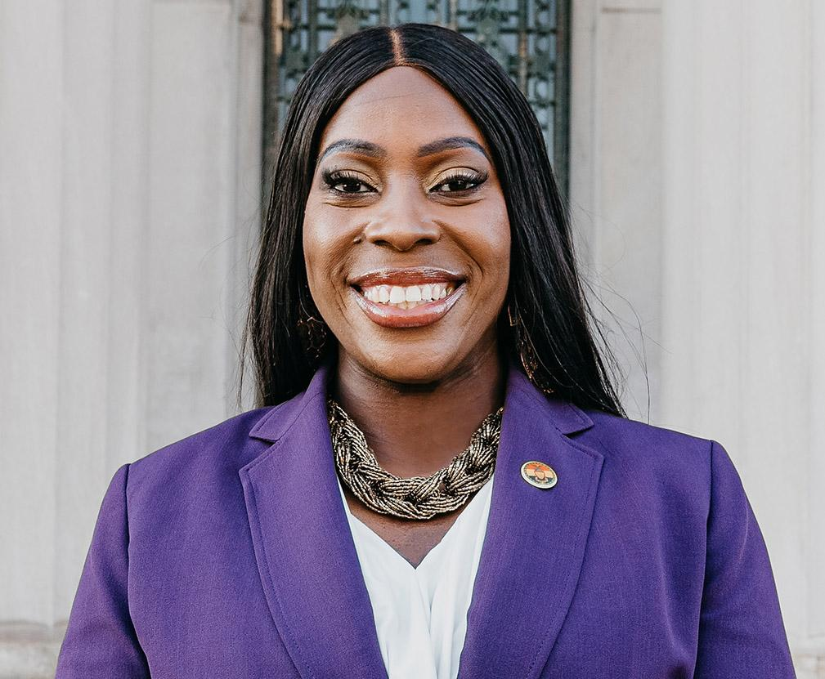
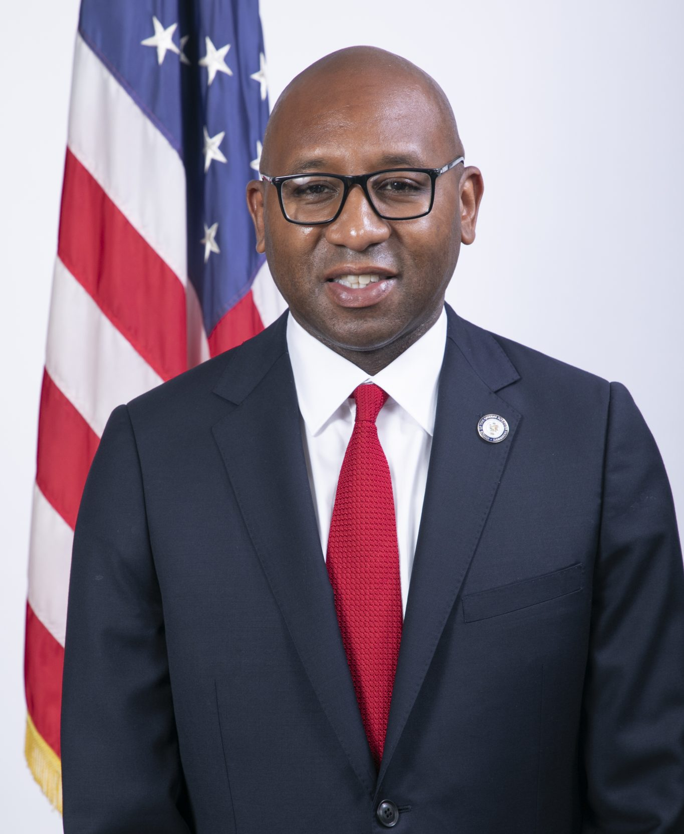
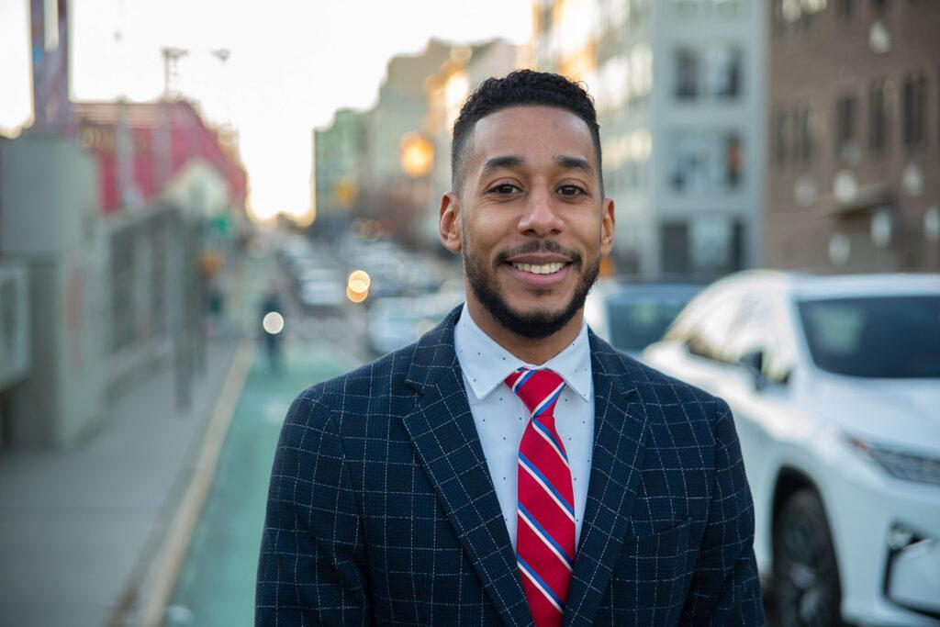
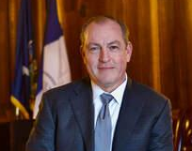
Current Borough Presidents
Mark Levine (Manhattan)
Vanessa Gibson (Bronx)
Donovan Richards (Queens)
Antonio Reynoso (Brooklyn)
Vito Fossella
(Staten Island)

Slide 13
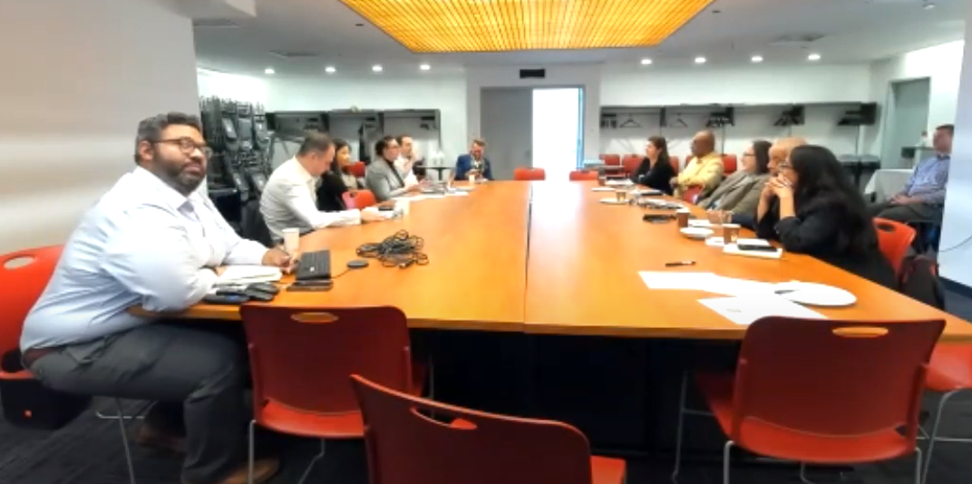
Borough Boards
Consists of
  Borough president
  Council members
  Community board chairs
Resolve inter-board issues
Address borough-wide concerns
Budget process
Manhattan Borough Board
Notes:
Now that we have talked about the citywide, let’s talk about at the borough level.
Mr. Kildahl and I read a 20-page law review on whether we even need this position.
(such as zoning, outdoor dining regulation, cannabis policy recommendations)

Slide 14
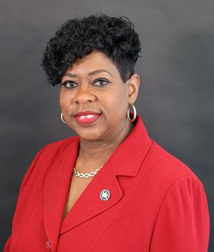
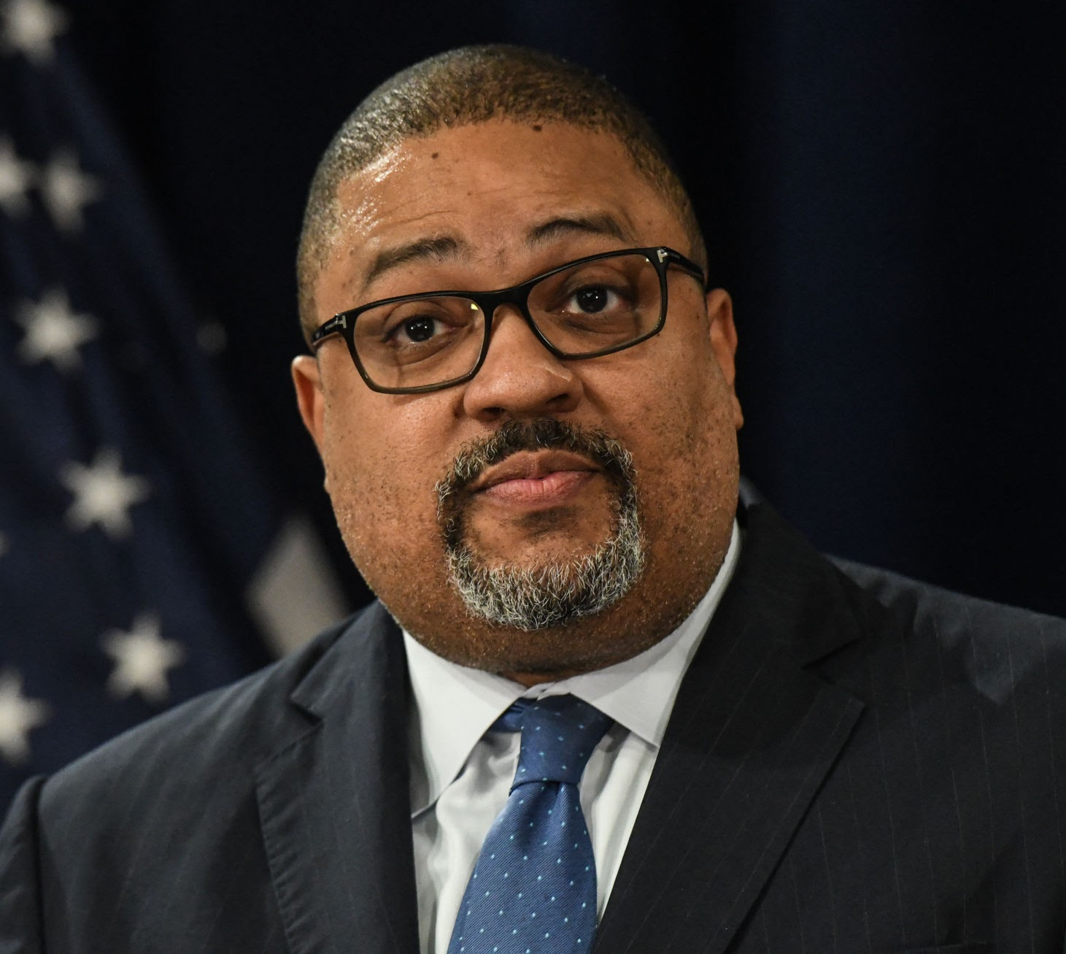
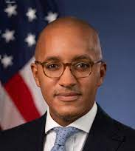
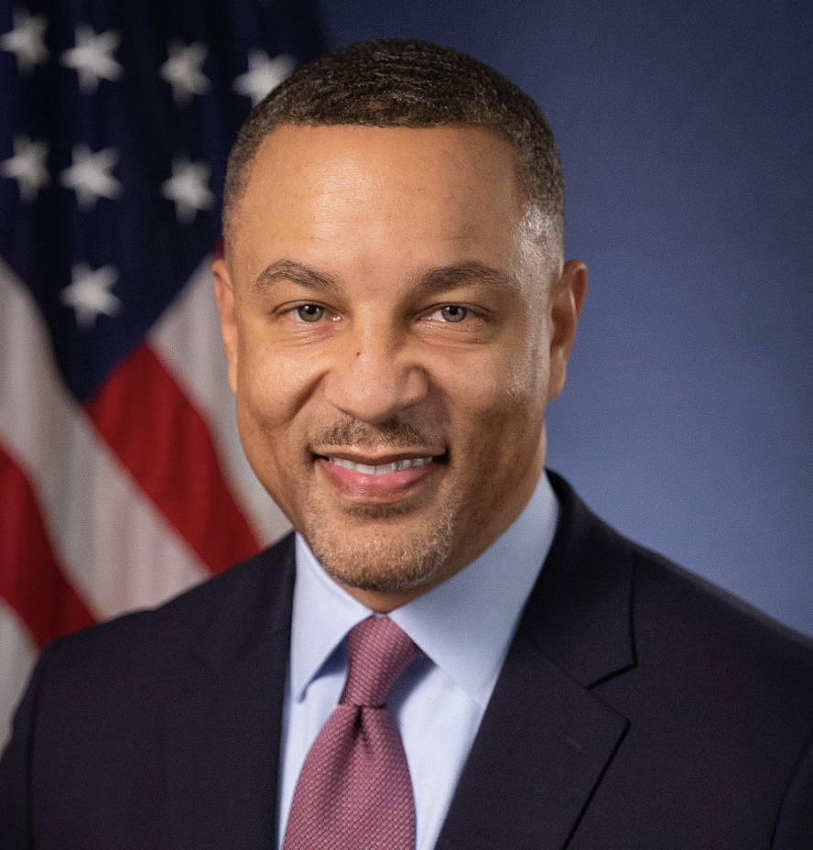
District Attorneys
U.S. Attorneys
Prosecute those who break state laws
One per borough
Elected by people
Prosecute those who break federal laws
SDNY - Manhattan, Bronx
EDNY - Brooklyn, Queens, SI
Nominated by president
Bronx DA Clark
Manhattan DA Bragg
SDNY Attorney Williams
EDNY Attorney Peace
Notes:
Not specific to NYC government.
In NYC, the counties are boroughs. If you break the state law in a borough, you are prosecuted by the borough DA
Mr. Kildahl and I also visited the Bronx DA’s indictment hearings
If you break federal law, you are prosecuted by

Slide 15
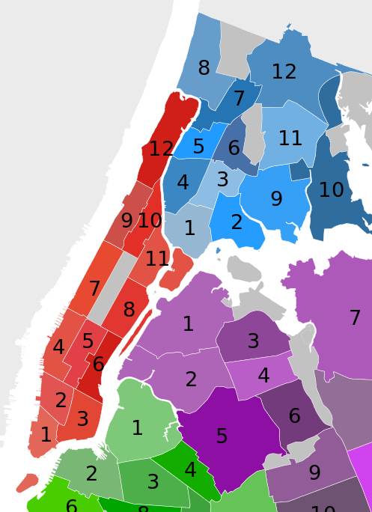
Community Boards
Consists of 50 residents
Voice for the neighborhood
Soft power
  Consulted for licenses (e.g., liquor, cannabis)
  Create resolutions for appropriate agencies
  Budget requests
Monthly meetings
Notes:
Show of hands, how many of you have heard of community boards? I certainly didn’t
Consulted for opinions on liquor licenses, bike lanes, block parties/street fairs permissions, and major construction projects
Minimum age is 16, so you can join
Each board has their own issues and different committees. Issues I have been dealing with have been climate resiliency flood walls, managing new marijuana shops, and opening more school maker spaces.
community boards are a way for local residents to have an impact on city policy. They are consulted by developers and government agencies for input on local projects because they are considered experts in their neighborhoods

Slide 16
Laws
Charter - establish government structure
Administrative Code - local laws created by Mayor & City Council
Rules - created by city agencies
Notes:
Charter - constitution
Administrative code - local laws
Erica Tishman died because local law 11 was not enforced
Building inspections
Energy audits
Rules - methods of operations
Department of Transportation traffic regulations.
Department of Health and Mental Hygiene rules about food service establishments.
Department of Sanitation rules about garbage and recycling.

Slide 17
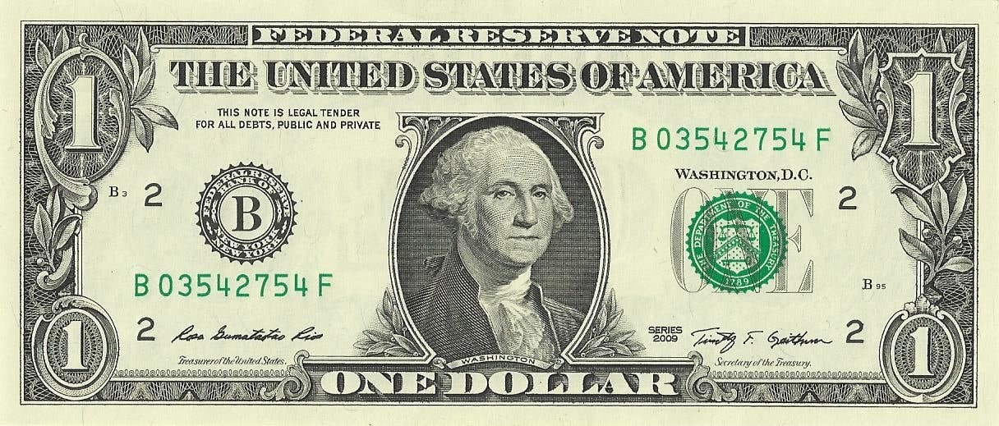
Budget
$113.7 billion
Expense budget - day-to-day operations
  Personnel
Capital budget - construction, physical improvements
Annual approval process
  Community boards give budget priorities
  Borough boards send in their priorities
  City Council makes recommendations to the mayor
  Mayor creates budget
  Council negotiates changes and approves
Notes:
Now, let’s talk about processes.

Slide 18
Budget
$113.7 billion
Agency | Adopted
Department of Education | $31.50b
Miscellaneous | $16.69b
Department of Social Services | $11.48b
Pension Contributions | $9.64b
Police Department | $5.80b
Department of Homeless Services | $4.11b
Administration for Children's Services | $2.74b
Debt Service | $2.76b
Agency | Adopted
Department of Health And Mental Hygiene | $2.20b
Fire Department | $2.30b
Department of Sanitation | $1.90b
Health And Hospitals Corporation | $1.82b
Department of Citywide Administrative Services | $1.64b
Department of Environmental Protection | $1.66b
Notes:
Here are the top agencies in the budget
https://www.checkbooknyc.com/budget/yeartype/B/year/125

Slide 19
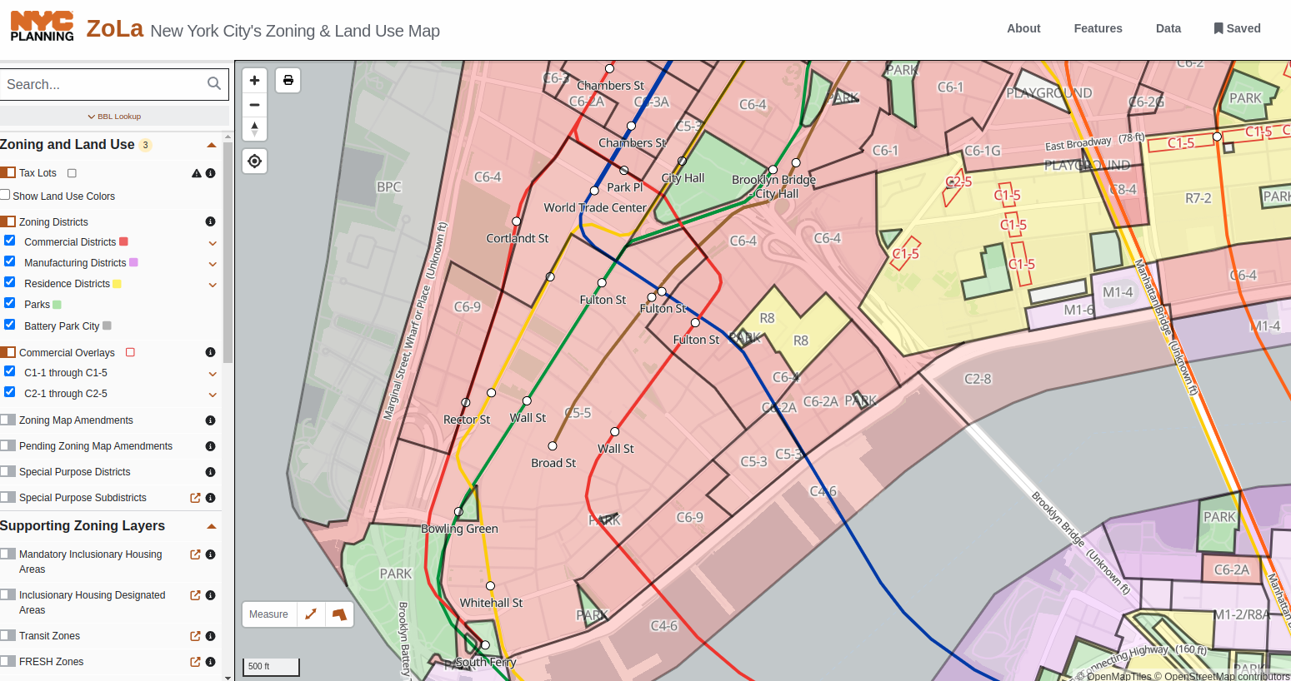
Zoning
Map - zoning districts specify what land can be used for
  Residential
  Commercial - retail, restaurants, hotels
  Industrial
  Institutional - schools, government
  Open Space
Zoning resolution (ZR) - regulations on land use in NYC
  Maintained by Department of City Planning (DCP)
Notes:
History
1870 Building Code - fire safety
1915 Equitable Building became last building according to “old rules”
1916 Zoning Resolution
Separated residential from non-residential (industrial and manufacturing)
Height controls
1961 Zoning Resolution
Examples of rules
Affordable housing requirements, building height

Slide 20
Uniform Land Use Review Procedure (ULURP)
Department of City Planning (DCP) certifies application
60 days - Community Board
30 days - Borough President and Borough Board
60 days - City Planning Commission (CPC)
50 days - City Council
5 days - Mayor
Notes:
In order to change the zoning code, you go through ULURP
https://www.nyc.gov/assets/planning/download/pdf/applicants/applicant-portal/lur.pdf

Slide 21
In Constant Change
1989 Board of Estimate dissolved. Power decentralized to City Council.
1993 Two-term limit on citywide elected officials
2002 Education decentralized from Board of Education
2003 311 created
2014 Community board age lowered to 16
2017 Centralized Jail (Rikers Island) → Borough-Based Jails
Last few decades: outcontracting
2050 ?
Notes:
mayor, comptroller, bps, president of council

Slide 22
Issues
Past overcome issues
  Decline of manufacturing and blue-collar jobs
  Bankruptcy in 1970s
  9/11
Present issues
  Flooding
  Migrant crisis
  Decline of office workers
  Lack of affordable housing
  Out of money
  Gentrification kicking communities out
Notes:
Through all these issues, people thought it was going to be the end, but NYC made it through.

Slide 23
How Can You Engage?
Vote for the mayor, comptroller, and public advocate and your borough president, district attorney, and city council member.
Become a community board member or public member
Submit comments to climate resiliency projects in your neighborhood
Notes:
Due to low turnout in council elections particularly, your vote does sway a lot
Presidential turnout: 65% in New York (typically)
12486/168000=7% in city council elections

Slide 24
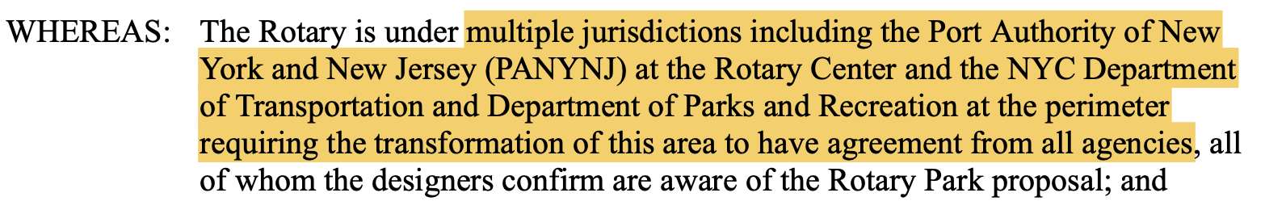
Learned Lessons
The Wendy Chapman Rule: all City Hall officials move at once. You may go from getting "no"s or no responses for years from different officials to all of a sudden one day they all say "yes."
The Third Law of Historical Motion: for every action, there is an equal and opposite reaction. Every big change results in pushback.
The Ron Kim Rule: it may be easier to make your opponent's voters not turn out to vote than it is to excite voters to vote for you.
The Backstage Decision Rule: debate in private before public discussion
The Overlapping Jurisdiction Theme:
Notes:
The Wendy Chapman Rule: all City Hall officials move at once. You may go from getting "no"s or no responses for years from different officials to all of a sudden one day they all say "yes."
Assemblyman Ron Kim said that it is easier to make your opponent's voters not turn out to vote than it is to excite voters to vote for you. I have noticed this in my council district's 2023 election. There were 23,212 voters in 2021 for Manhattan Council District 1 but only 12,486 in 2023 (source). This low turnout occurred after attack ads against the incument Councilmember Marte from Susan Lee in the primary and Helen Qiu in the general election were put all over the district: on the buildings, in shops, and in the mail. Turnout went down by about half, likely because these ads made Marte supporters not want to vote.
Turnout in my district went down by ½ after Republican attack ads
The Backstage Decision Rule: debate in private before public discussion
City Council discussions occur backstage. If something does not get a majority, speaker will not put it on agenda
Good idea to run ideas before other community board members before bringing it up to community board meeting for first time so that they agree when it is official

Slide 25
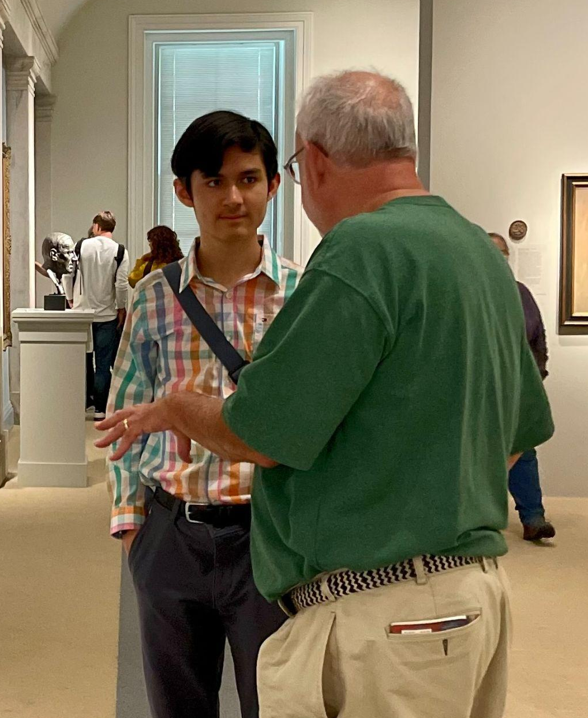
Acknowledgements
Mr. Kildahl
Speakers
  Egor Shakhnovskiy
  Assemblyman Ron Kim
  Councilmember Christopher Marte
  Catherine Hughes

Slide 26

Learn More
Curriculum at joelgrayson.com/nyc-government
Notes:
Curriculum with readings, an essay, and a quiz.
Presentation on coastal resiliency: youtu.be/XXXXXX

Slide 27
Economy In Constant Change
Beaver fur trade
Grain processing
Shipping port
Clothing industry
Manufacturing
Office work
Residential

Slide 28
NGOs
Robin Hood Foundation - Riverdale parent cofounders
Notes:
It’s worth noting the NGOs which also have an impact on New Yorkers

